Slide 1
VPN: WHY AND HOW
Govind Sharma | 162391189
Ops300
8 April 2023

Slide 2
Why VPN?
Encryption of traffic
Secure connection to network resources/assets

Slide 3
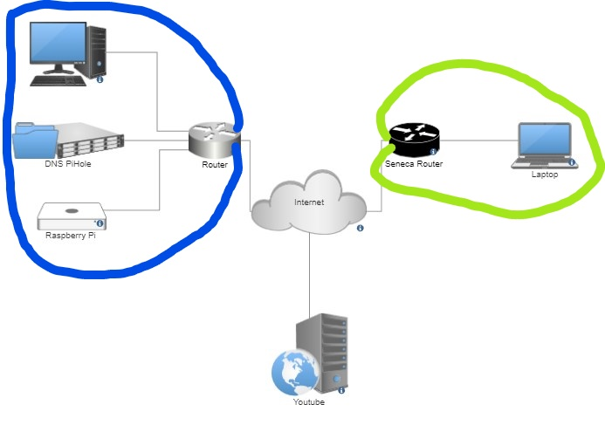
Notes:
Break up into coloured chunks
DON’T REFERENCE COLOURS
Youtube from home vs Seneca
Why pi?

Slide 4
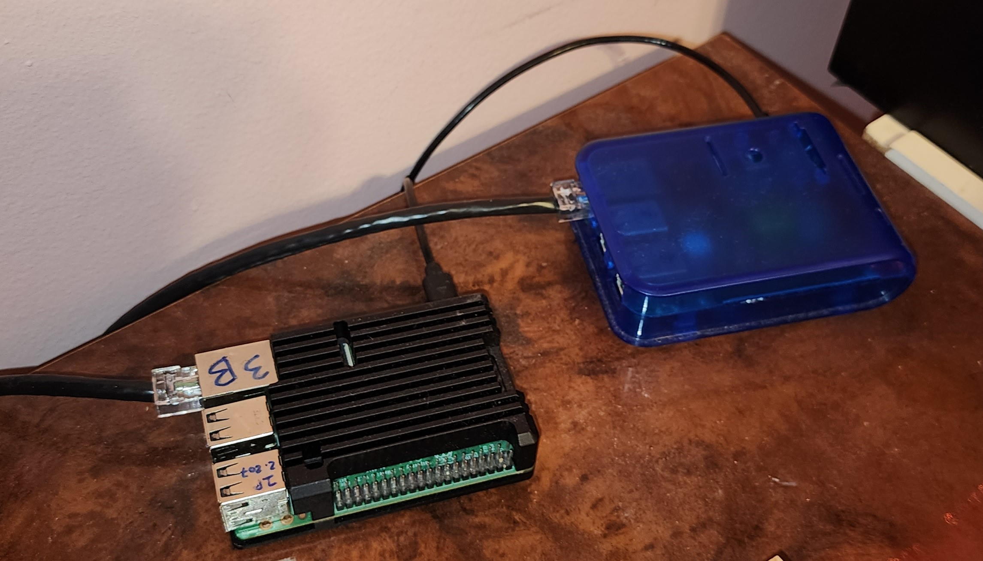
Why pi?
Notes:
Power,
Smol
Space, temps
Big vpn needs big cpu for encrypting for fast

Slide 5
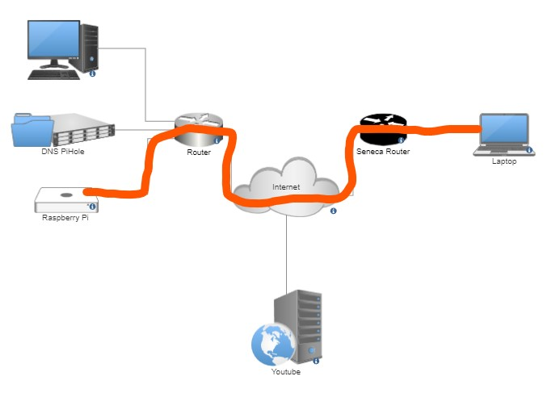
Notes:
Tunnel using config file wireguard
Secure network tunnel
Seneca will only see

Slide 6
Configuration

Slide 7
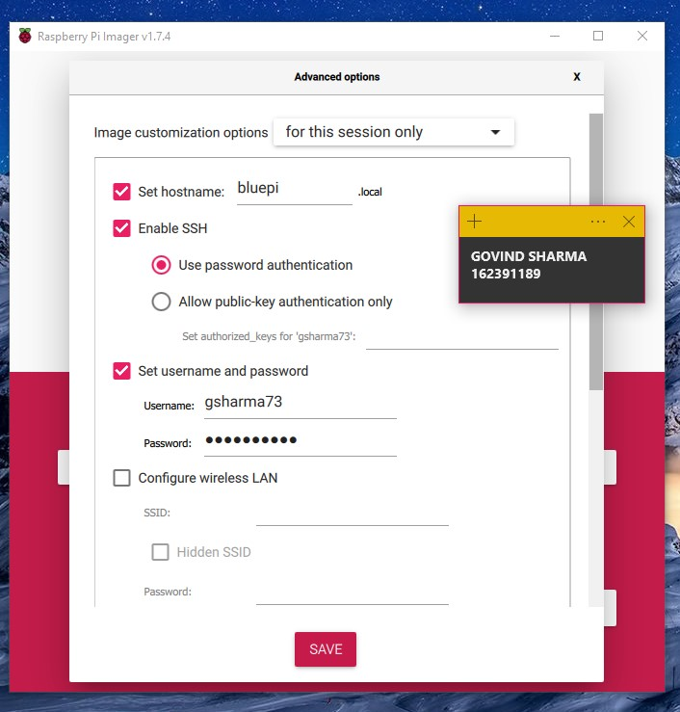
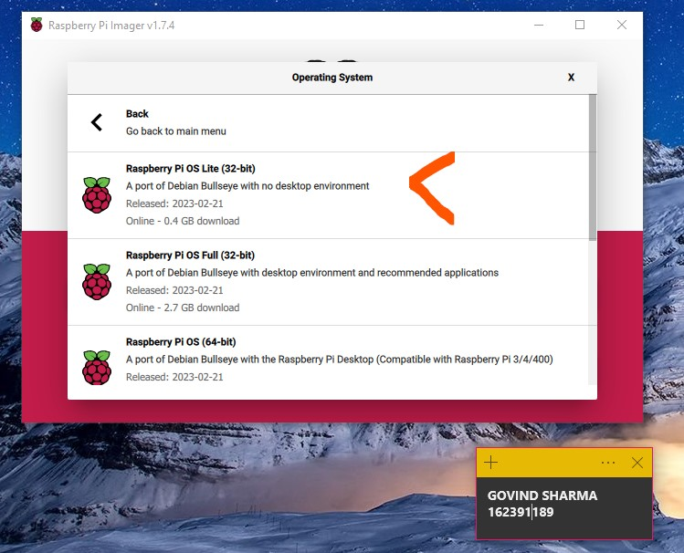
Notes:
Micro sd format with name and ssh enabled for headless

Slide 8
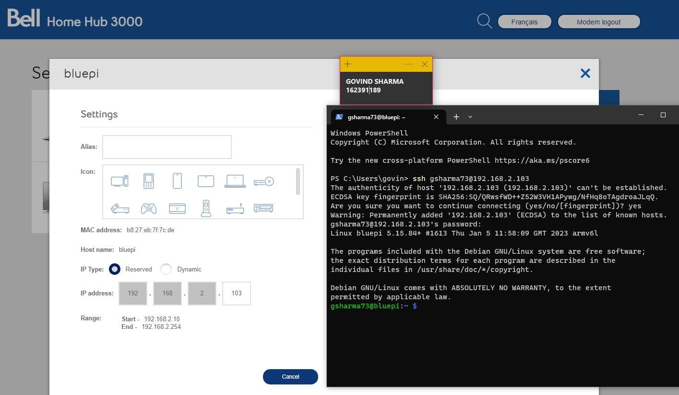
Notes:
Static ip and ssh login

Slide 9
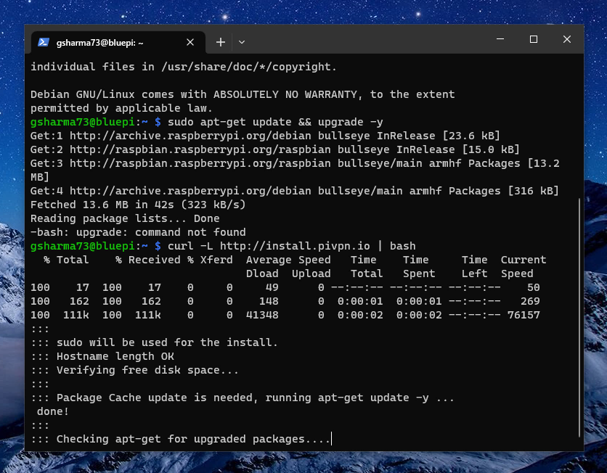

Slide 10
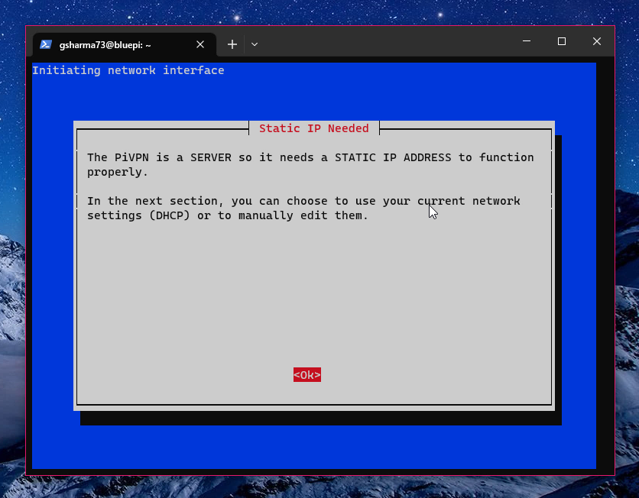

Slide 11
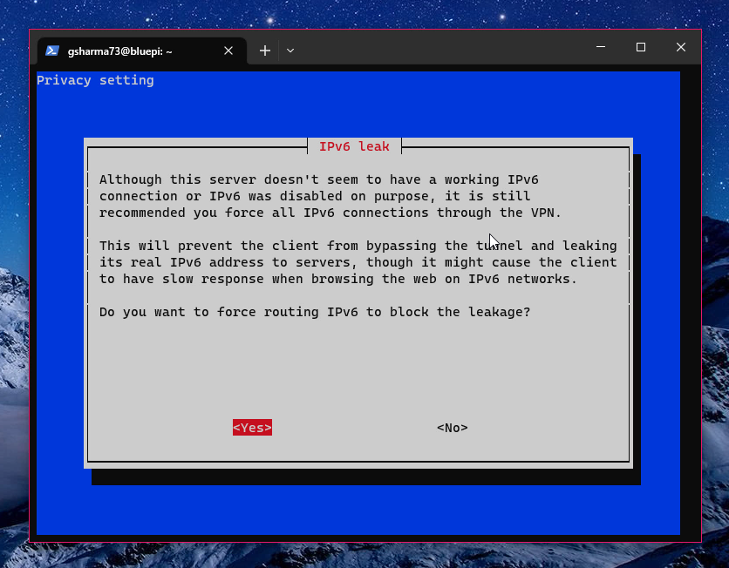
Mistake!
Notes:
Ipv6 force routing to prevent ipv6 leaking
Ipv6 leaking is when you connect to a webserver that uses ipv6 for its server and internet connectivity but the vpn is only using ipv4 (if ipv6 is disabled or if it sent force routed for packets)
The server is connecting to your vpn via ipv6 and because the vpn is not properly configed for it the webserver sees your actual ip in senecas network

Slide 12
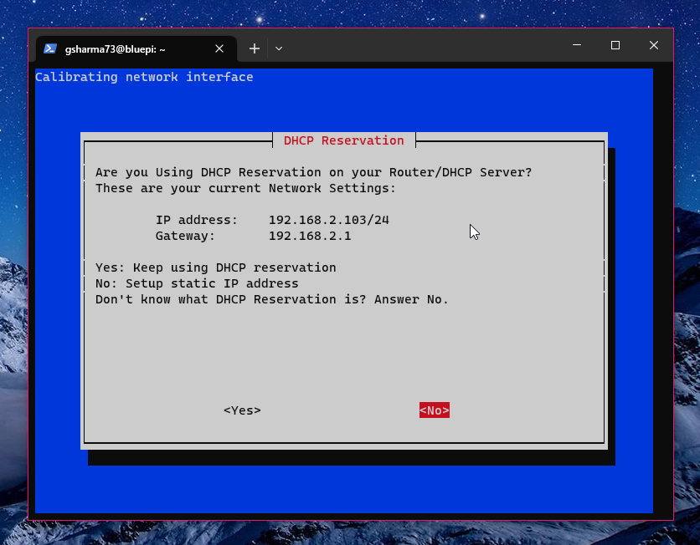

Slide 13
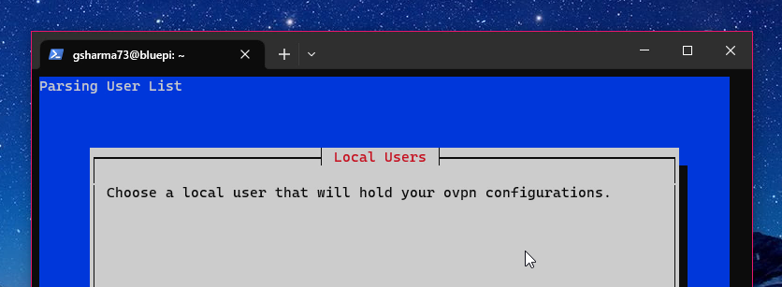
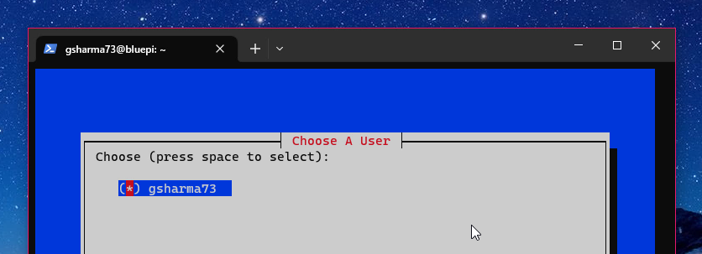

Slide 14
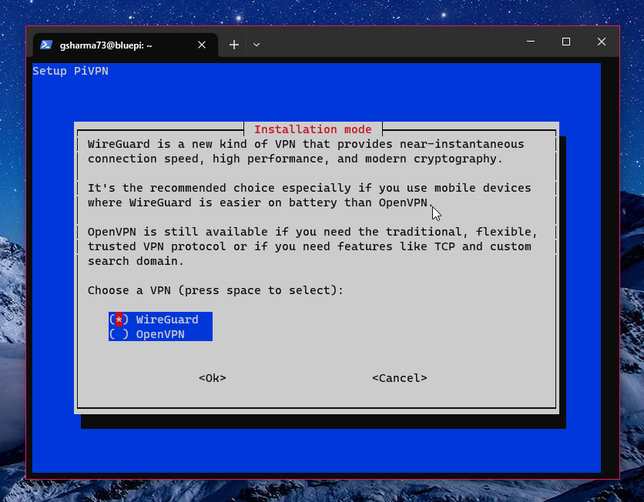
Notes:
Openvpn known and customizable but bloated and too big for a security audit
Wireguard is simple and strong, able to audit with one person

Slide 15
Wireguard
Secure network tunnel
Less than 4,000 lines of code
Performance
Light and efficient
Key Pair Exchange
XChaCha20 Encryption
Stream Cipher

Slide 16
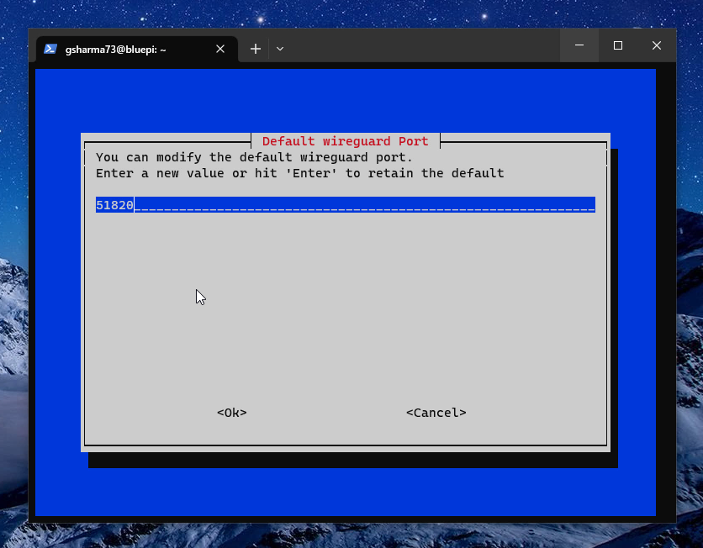

Slide 17
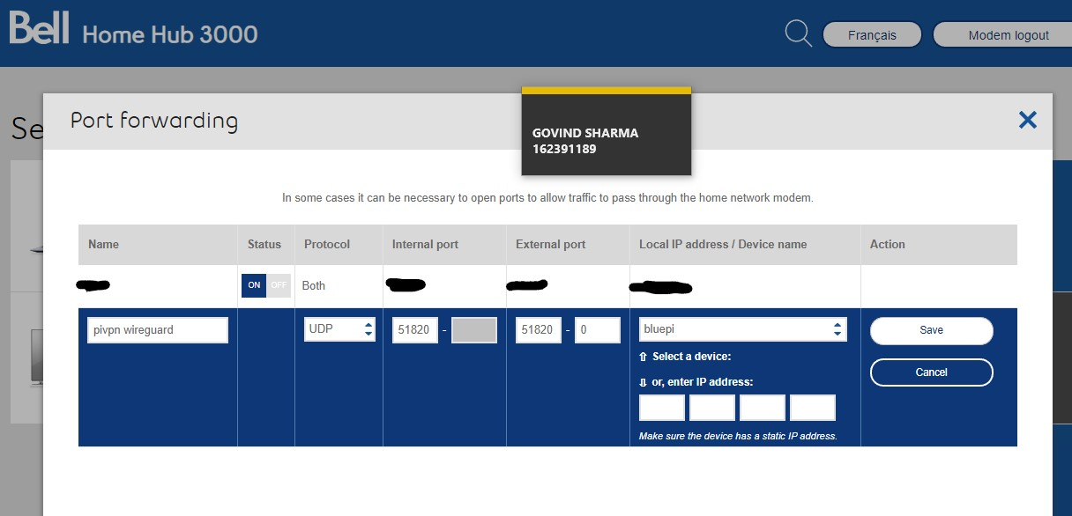
Notes:
Set rule in home router for port forwarding
Make sure only udp for security and only for one ip

Slide 18
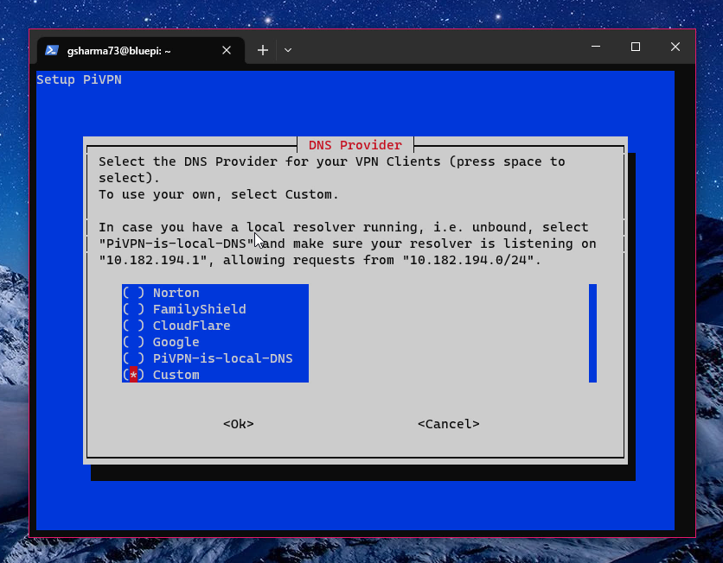

Slide 19
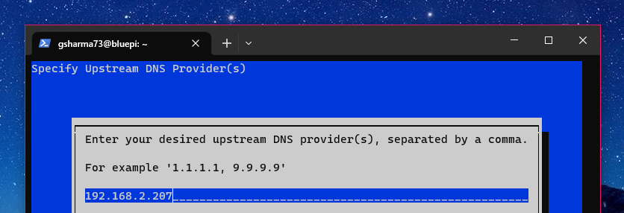
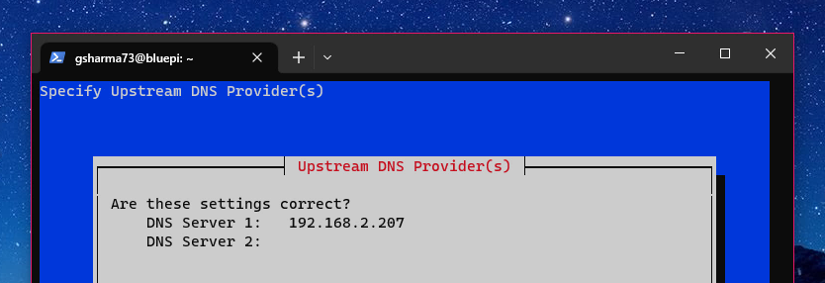

Slide 20
Notes:
that blackpi is the dns server that runs pihole a software that helps to sink all dns queries to common ad servers, it helps to block adds
This is one of the resources one might need to access,

Slide 21
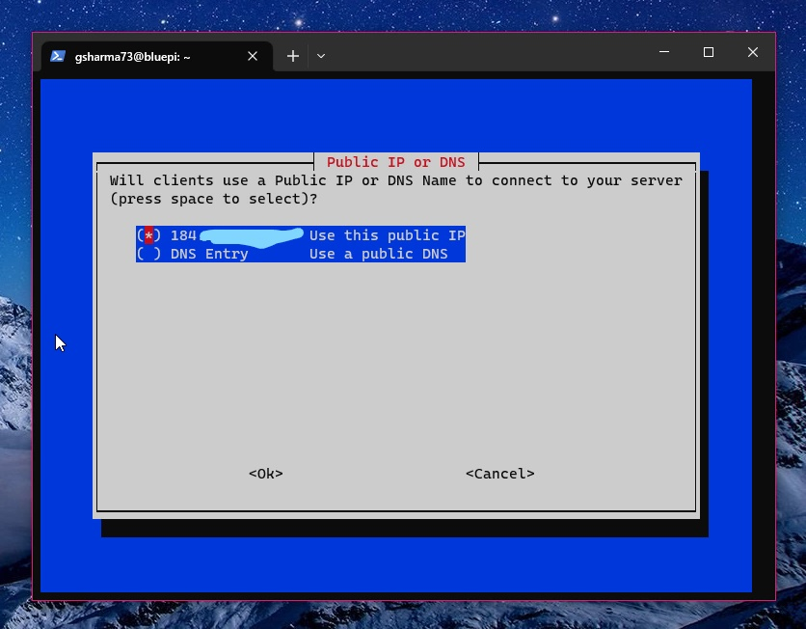
Notes:
I used my public ip for this but a better way would be to register a public dns entry, essentialy pointing a domain name to a ip address,
In my case, choosing wireguard, this does not matter as all the information such as the public ip is in a config file and aren’t nessisary to remember.

Slide 22
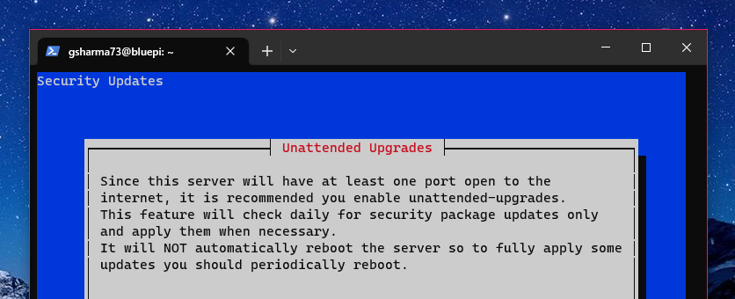
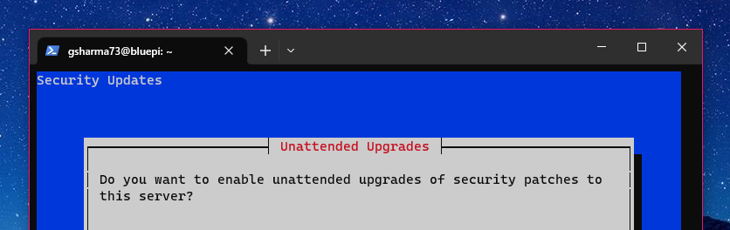

Slide 23
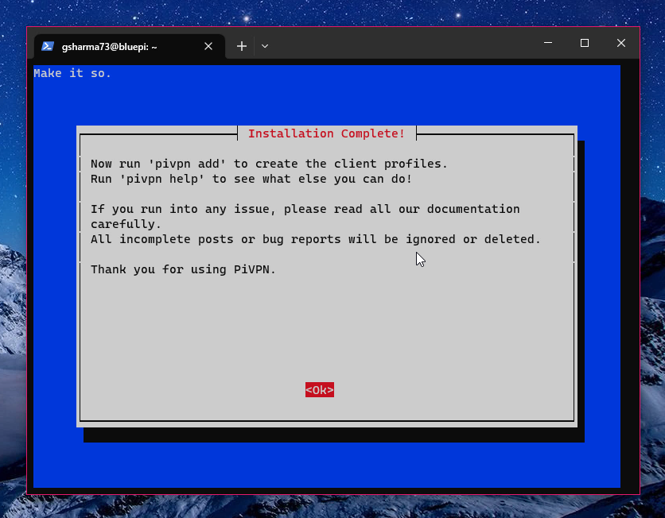

Slide 24
Management

Slide 25
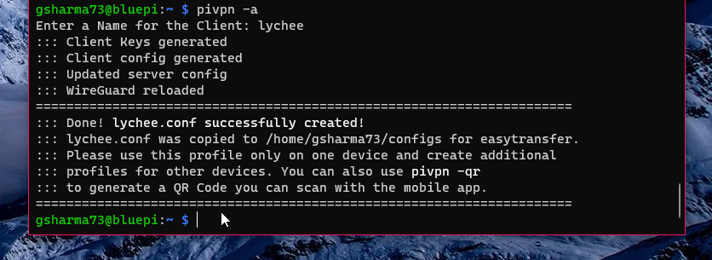

Slide 26
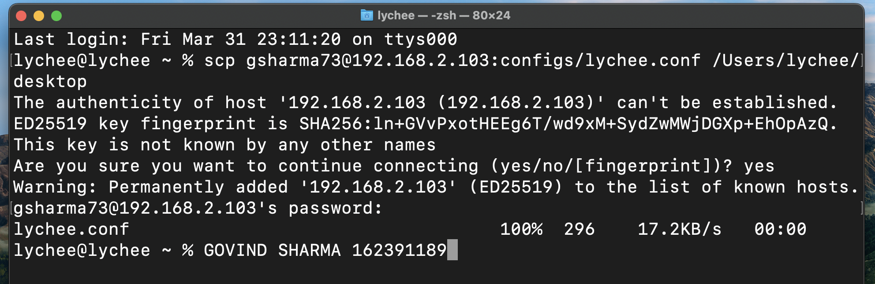
Notes:
On my laptop I used the secure copy command to copy over the config file I created for my laptop, I then transferred it to my desktop

Slide 27
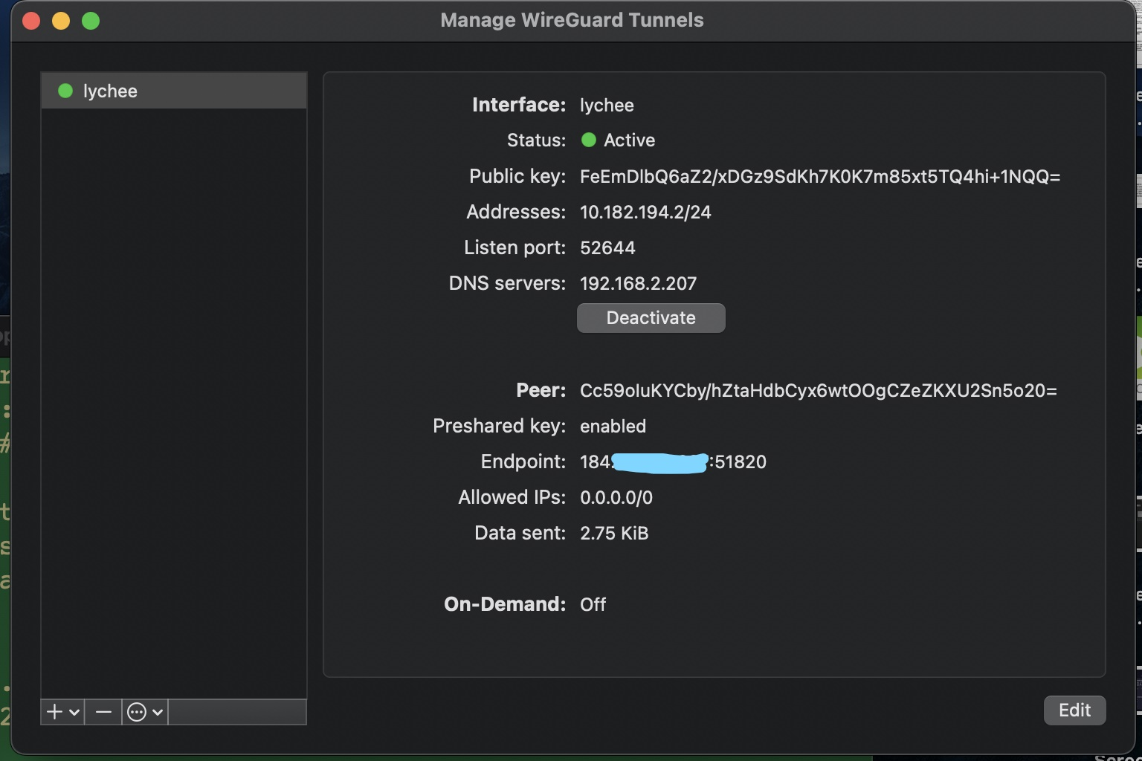

Slide 28
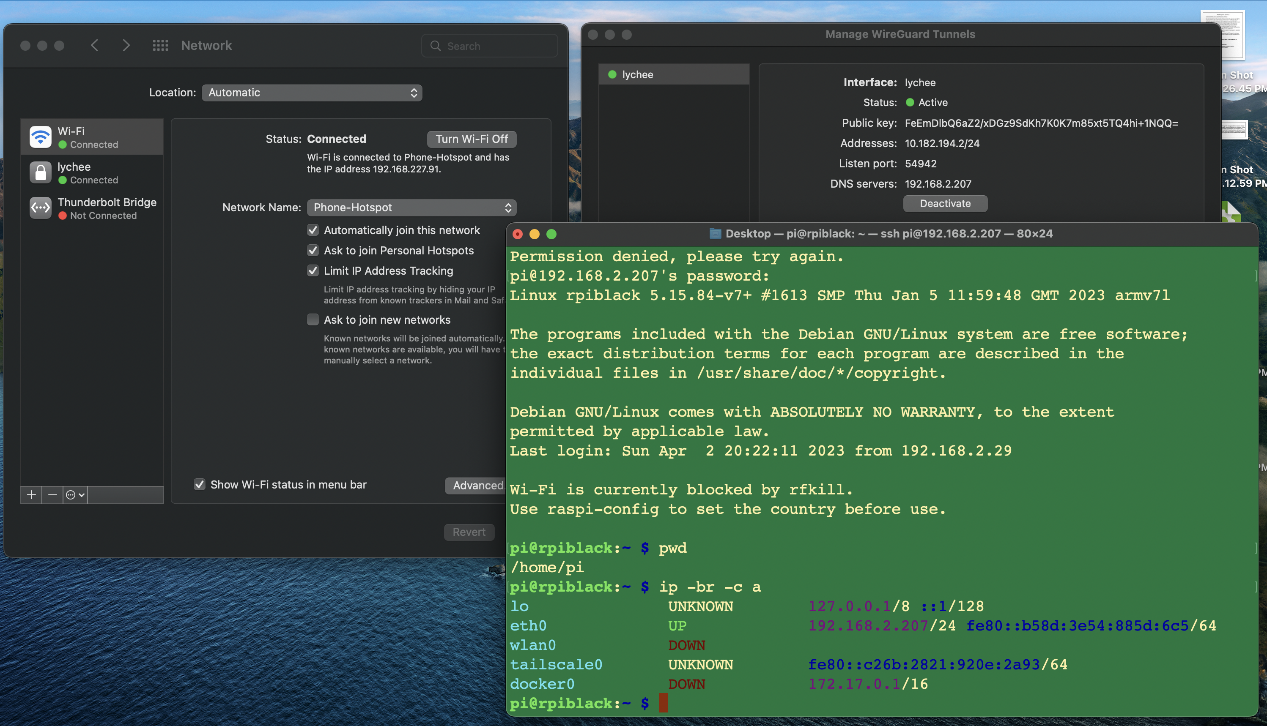

Slide 29
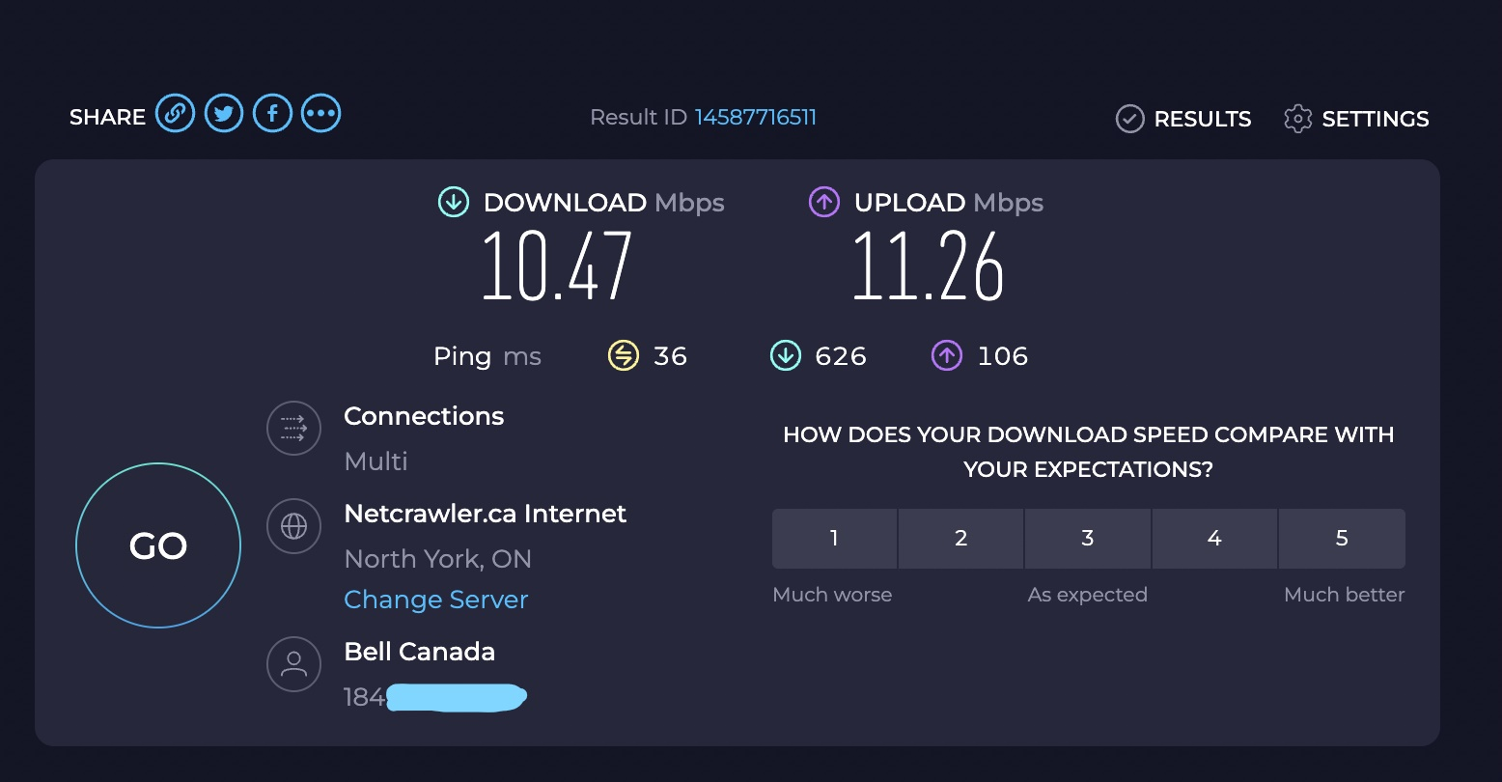

Slide 30
best practices (Do as I say not as I do)
Keep the conf file secret, do not share it.
Flash Drive?
Secondary account?
Some VPNs are free, that means YOU are the product
IPv6 force routing to prevent IPv6 leaking
Regular automatic updating
Notes:
If someone gets the config file they can connect to your VPNso it should be kept secret and potentially hidden,
Could keep it on a flash drive in cold storage
Or on a secondary account so that main work is done on one and vpn needed work can be done on a separate seldom used account

